Slide 1
CLAS 220 Introduction to Classical Mythology
Homer, Iliad 9-12

Slide 2
Quiz Question
Which of the following heroes is NOT part of the Embassy to Achilles?
Odysseus
Phoenix
Paris
Ajax

Slide 3
Quiz Question
2. What is Achilles doing when the embassy reaches him?
Planting a garden
Polishing his armor
Singing songs about the kleos of men
Weaving a tapestry about the Trojan War

Slide 4
Quiz Question
3. Which of the following is true about the relationship between kleos (fame) and nostos (homecoming) for Achilles?
He can’t have kleos without nostos
He can’t have nostos without kleos
He can have either kleos or nostos, but not both
He can have neither kleos nor nostos

Slide 5
What do you do when your best hero won’t fight?
Single combat: Paris v. Menelaus
Singe combat: Ajax v. Hector
Aristeia (finest hour) of Diomedes
Aristea of Agamemnon
Embassy to Achilles
Night raid

Slide 6
Divisions of the Iliad
In thirds:
1-8 Achilles completely out of battle
9-16 Patroclus doubles for Achilles
17-24 Achilles returns
In halves:
1-12 Things get worse and worse for the Greeks
13-24 The Greeks recover, but at great cost

Slide 7
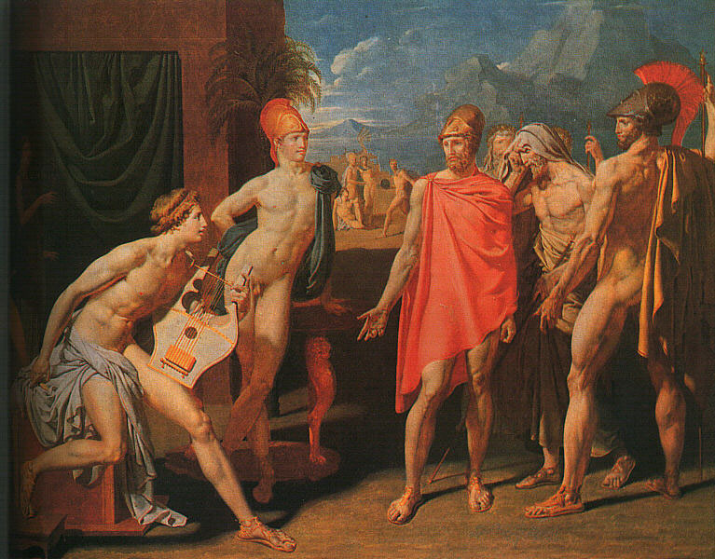
Embassy to Achilles

Slide 8
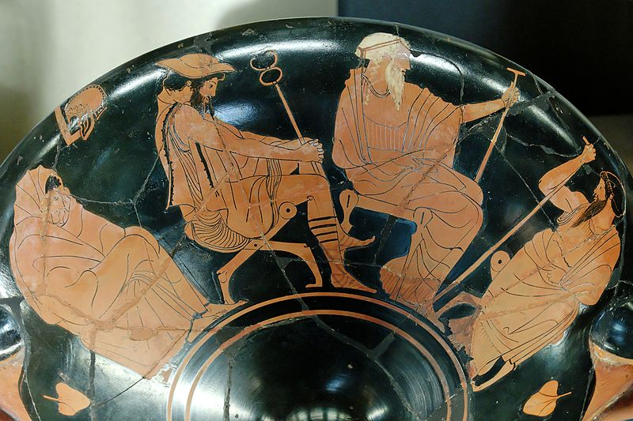
Embassy to Achilles
“I lost my head, I yielded to black anger,
But now I would retract it and appease him
With all munificence. Here before everyone
I may enumerate the gifts I’ll give.
Seven new tripods and ten bars of gold,
Then twenty shining cauldrons and twelve horses,…
Then I shall give him seven women, deft…
These I shall give him, and one more, whom I
Took away from him then: Briseus’ daughter.
Concerning her, I add my solemn oath
I never went to bed or coupled with her,
As custom is with men and women.
These will be his at once. If the immortals
Grant us the plundering of Priam’s town…
These are the gifts I shall arrange if he
Desists from anger. Let him be subdued!
Lord Death indeed is deaf to appeal, implacable;
Of all gods therefore he is most abhorrent
To mortal men. So let Akhilleus bow to me,
Considering that I hold higher rank
And claim the precedence of age.
9. 143-95

Slide 9
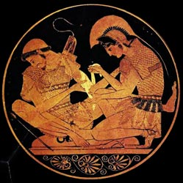
Kleos andrôn
Amid the ships and huts of the Myrmidons
They found him, taking joy in a sweet harp
Of rich and delicate make – the crossbar set
To hold the strings being silver. He had won it
When he destroyed the city of Eetion,
And plucking it he took his joy: he sang
Old tales of heroes (kleos andrôn), while across the room
Alone and silent sat Patroklos, waiting
Until Akhilleus should be done with song.
9. 223-31

Slide 10
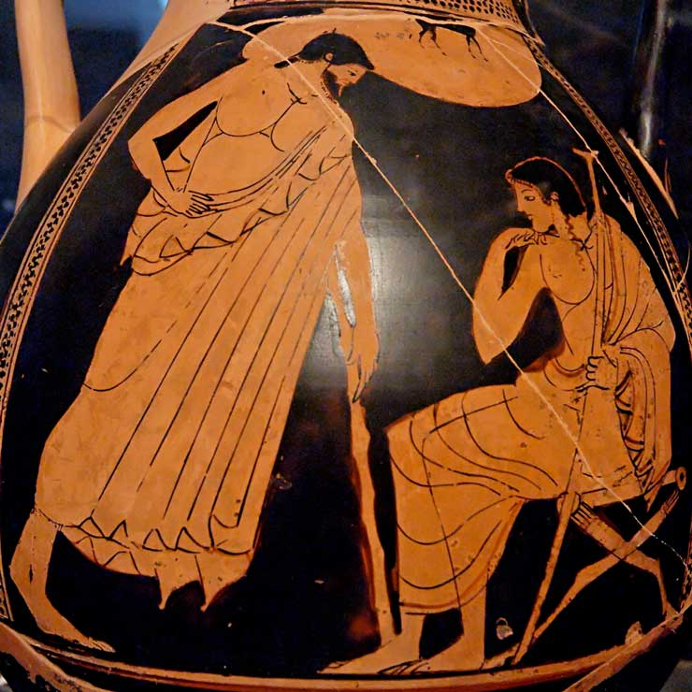
Odysseus’ Speech
Now listen and let me list for you
What just now in his quarters he proposed:
Seven new tripods and ten bars of gold,
Then twenty shining cauldrons and twelve horses…
Then I shall give him seven women, deft…
These I shall give him, and one more, whom I
Took away from him then: Briseus’ daughter.
Concerning her, I add my solemn oath
I never went to bed or coupled with her,
As custom is with men and women.
These will be his at once. If the immortals
Grant us the plundering of Priam’s town…
These are the gifts he will arrange if you
Desist from anger.
9. 320-65

Slide 11
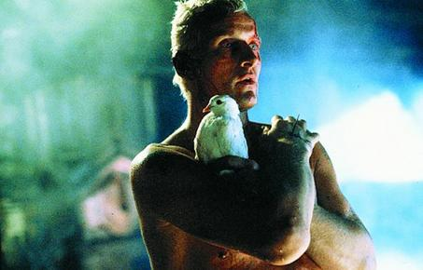
Achilles’ Response
“Now I think
No riches can compare with being alive,
Not even those they say this well-built Ilion
Stored up in peace before the Achaeans came.
Neither could all the Archer’s shrine contains
At rocky Pytho, in the crypt of stone.
A man may come by cattle and sheep in raids;
Tripods he buys, and tawny-headed horses;
But his life’s breath cannot be hunted back
Or be recaptured once it pass his lips.
My mother, Thetis of the silvery feet,
Tells me of two possible destinies
Carrying me toward death: two ways:
If on the one hand I remain to fight
Around Troy town, I lose all hope of home
But gain unfading glory; on the other,
If I sail back to my own land my glory
Fails – but a long life lies ahead for me.”
9.489-50

Slide 12
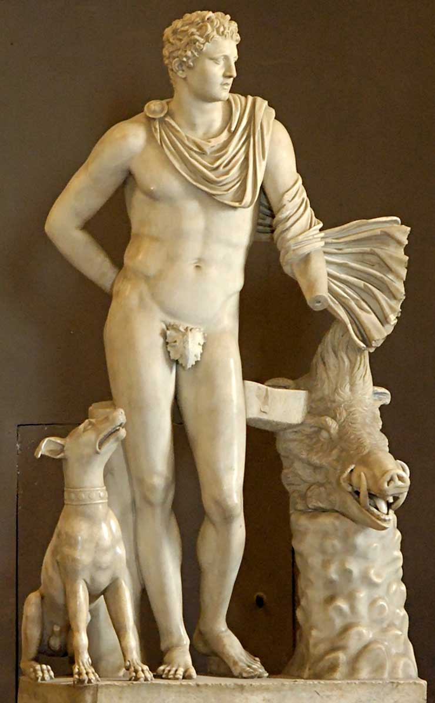
Phoenix’s Speech: Meleager and Kleopatra
Phoenix, Achilles’ mentor, tries to persuade him through the telling of a myth, that of the Calydonian boar.
This boar (or rather the honor of keeping its head), was the subject of a war between Meleager’s people, the Aitolians, and their rivals, the Kouretes.
The hero Meleager was leading the battle, but was offended by his mother, and so he withdrew to spend time with his wife (Kleopatre).
A series of people beg him to come back to the fight:
The old men (with prizes), his father, sisters, mother, friends, all to no avail.
Then his wife begs him to fight, and he does, but at great cost.

Slide 13
Phoenix’ speech: Meleager and Kleopatra
Note that Kleopatra=Patroklos
both mean “kleos of the fathers”
The story of Meleager is an example of an ainos, a kind of encrypted speech that only makes sense if you have the right intellectual, emotional and social intelligence to decode it.
Ainos can mean:
Riddle
Fable (Aesop)
Song of praise

Slide 14
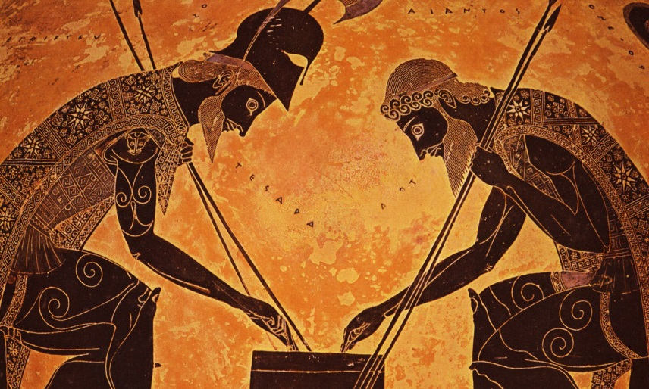
Ajax’s Speech (addressed to Odysseus)
“There is no pity in him. A normal man
Will take the penalty for a brother slain
Or a dead son. By paying much, the one
Who did the deed may stay unharmed at home.
Fury and pride in the bereaved are curbed
When he accepts the penalty. Not you.
Cruel and unappeasable rage the gods
Put in you for one girl alone. We offer
Seven beauties, and much more besides!
(9. 769-777)

Slide 15
Quiz Question
4. Which heroes participate in the night raid on the Trojans?
Odysseus and Ajax
Odysseus and Diomedes
Diomedes and Ajax
Nestor and Phoenix

Slide 16
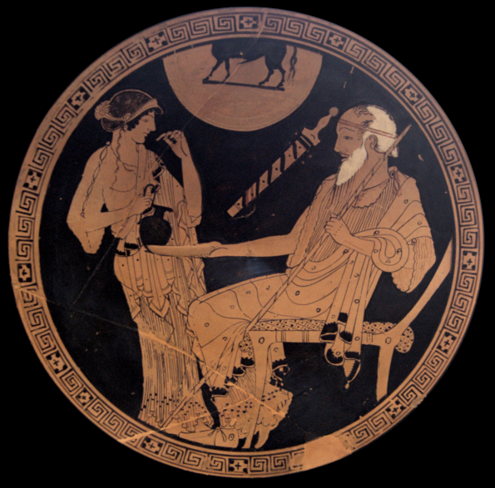
Sleepless leaders
I roam this way because no sleep will come
To settle on my eyes; the war stays with me
And what the army suffers. How I fear
For our Akhaians! Quietude of heart
I have none: fever of dread is in my brain,
My heart leaps from my ribs, my knees give way….
(10. 101-106)

Slide 17
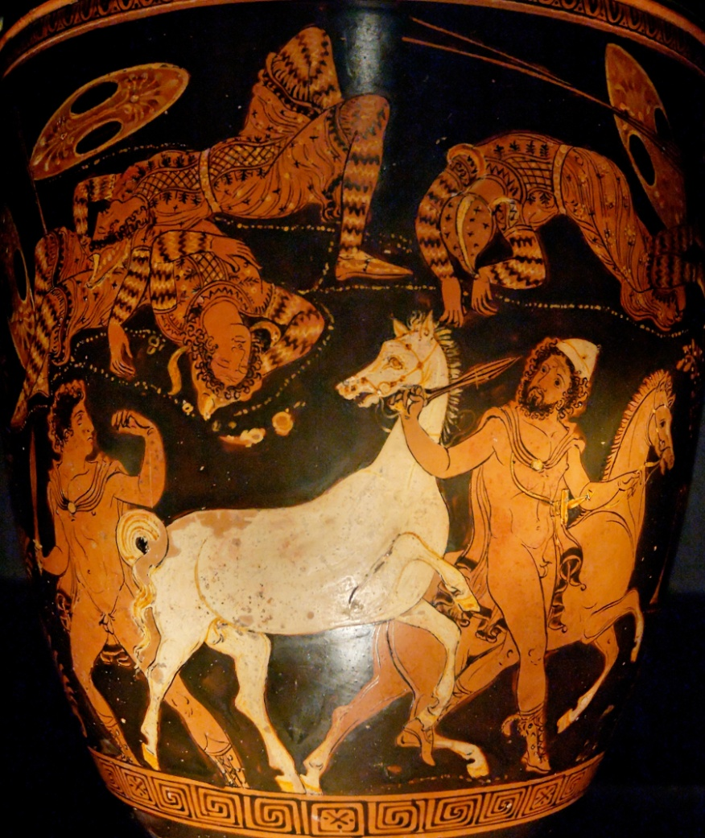
Night Raid
Whirling left and right he struck,
And pitiable sounds came from the bodies
Cleft by the sword’s edge. Earth ran red with blood.
As on a flock of goats or sheep, unshepherded
The son of Tydeus fell upon those Thracians
Until he had killed twelve. And at his shoulder
Odysseus, adept at war, moved up
To drag out by the heels each man he killed,
Thinking by this to save the beautiful horses
From shying at the bodies when they passed –
Being unused to dead men yet.
When Diomedes reached the Thracian king,
He took a thirteenth precious life away
As the man gasped in sleep, nightmare upon him.
(10. 535-49)

Slide 18
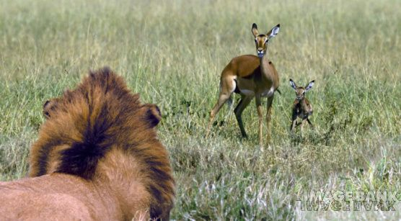
Agamemnon’s Finest Hour
Now the Lord of the Great Plains, Agamemnon,
Hit one with a spear-cast in the chest
Above the nipple; the other, Antiphos,
He struck with his long sword beside the ear,
Toppling him from his car. He bent to take
Their arms and knew them…
A lion, discovering a forest bed,
And picking up in his great fangs the fawns
Of a swift doe, will shake and break their backs
And rend their tender lives away with ease,
While she is powerless to help, though near,
But feels a dreadful trembling come upon her;
Bolting the spot, she leaps through underbrush
At full stretch, drenched in sweat, before the onset
Of the strong beast of prey. Just so…
(11.119-134)

Slide 19
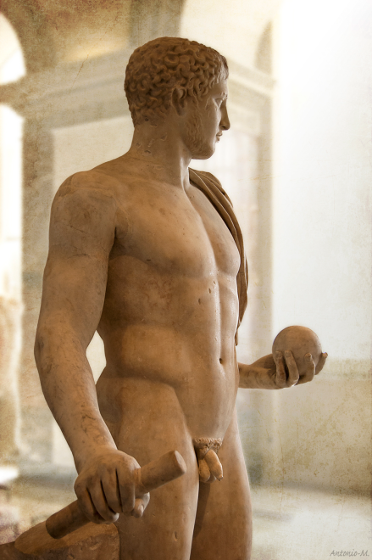
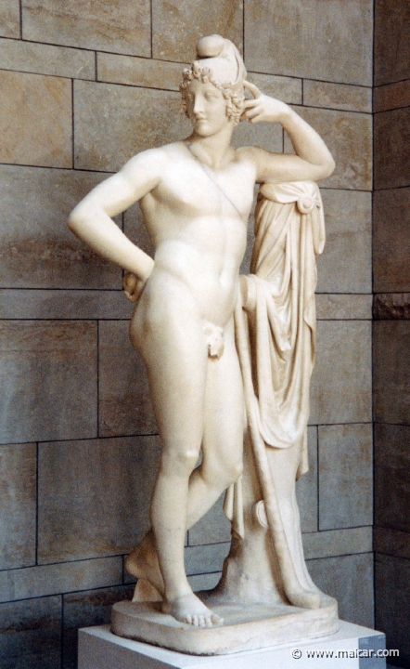
Diomedes Injured
Imagine Diomedes taking the dead man’s
Cuirass from his ribs, and from his shoulders
The shield all glimmering, and his heavy helm
Even as the adversary drew his bow
To the grip and shot – and not in vain the arrow
Sprang from his fist, but through the right foot bonework
Of Diomedes into the earth it punched.
Alexandros (Paris) jumped out of ambush laughing
And called to him vaunting: “Hit you are, and hard! No wasted shot, that!”
(11.424-33)

Slide 20
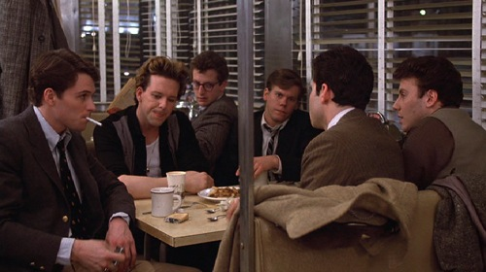
Diomedes taunts Paris
“You bow-and-arrow boy, you curly-head,
All eyes for little girls, I wish you’d try me
Face to face with pike and shield: your archery
Would do you no good then. You brag this way
For having scratched my instep. It is nothing,
A woman’s shot, or a silly little boy’s.
A weak-kneed half-wit’s arrow has no point!
By heaven, arrows of mine are whetted differently.
One that grazes a man will stretch him dead.
His woman’s cheeks are torn with grief,
His children orphaned. He must soak the earth
And rot, with kites for company, not women!
(11. 438-49)
“I’ll hit you so hard, I’ll kill your whole family.”
Billy (Tim Daly) from Diner (1982)
I’ll beat you like a red-headed stepchild.
I’ll beat you like a rented mule….

Slide 21
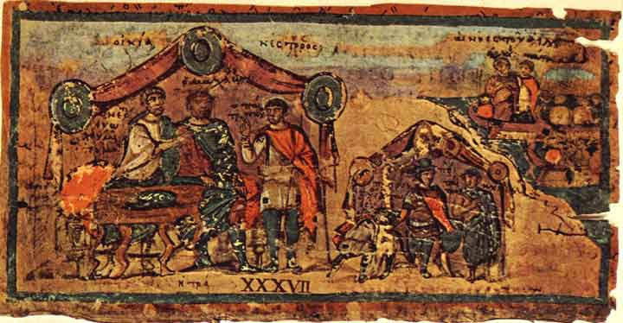
Patroclus and Nestor
“And now your fathers both
Repeatedly enjoined your duties on you.
The old man, Peleus, urged his child, Akhilleus,
To do none but great feats, to be distinguished
Above the rest. As for Menoitios,
The son of Aktor, these were his words to you:
“My child, Akhilleus is a higher being
By his immortal blood; but you are older.
He is more powerful, but your part should be
To let him hear close reasoning and counsel,
Even commands. He will be swayed by you
For his good.” These were your father’s words,
Although you now forget them.
(11. 902-913)

Slide 22
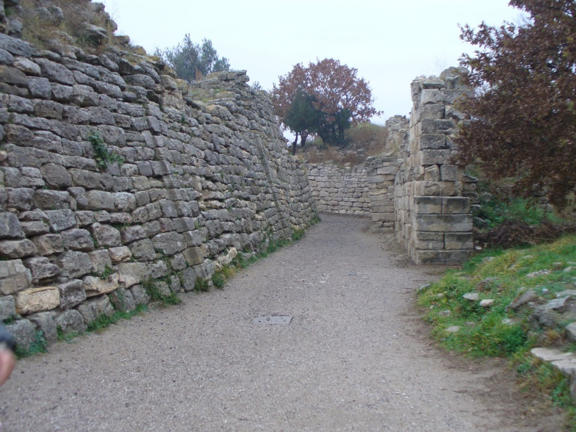
The Ramparts
While Hektor lived and while Akhilleus raged,
And while Lord Priam’s town lived on, unsacked,
So long the Akhaian’s rampart stood. But after
The flower of Troy went down, with many Argives
Fallen or bereft, when Priam’s Troy
Was plundered in the tenth year, and the Argives
Shipped again for their dear homeland – then
Poseidon and Apollo joined to work
Erosion of the wall by fury of rivers
Borne in flood against it, all that flow
Seaward from Ida: Rhesos, Heptaporos,
Karesos, Rhodios, Grenikos, Aisepos,
Skamander’s ancient stream, and Simoies
Round which so many shields and crested helms
Had crashed in dust with men who were half gods.
(12. 11-26)

Slide 23
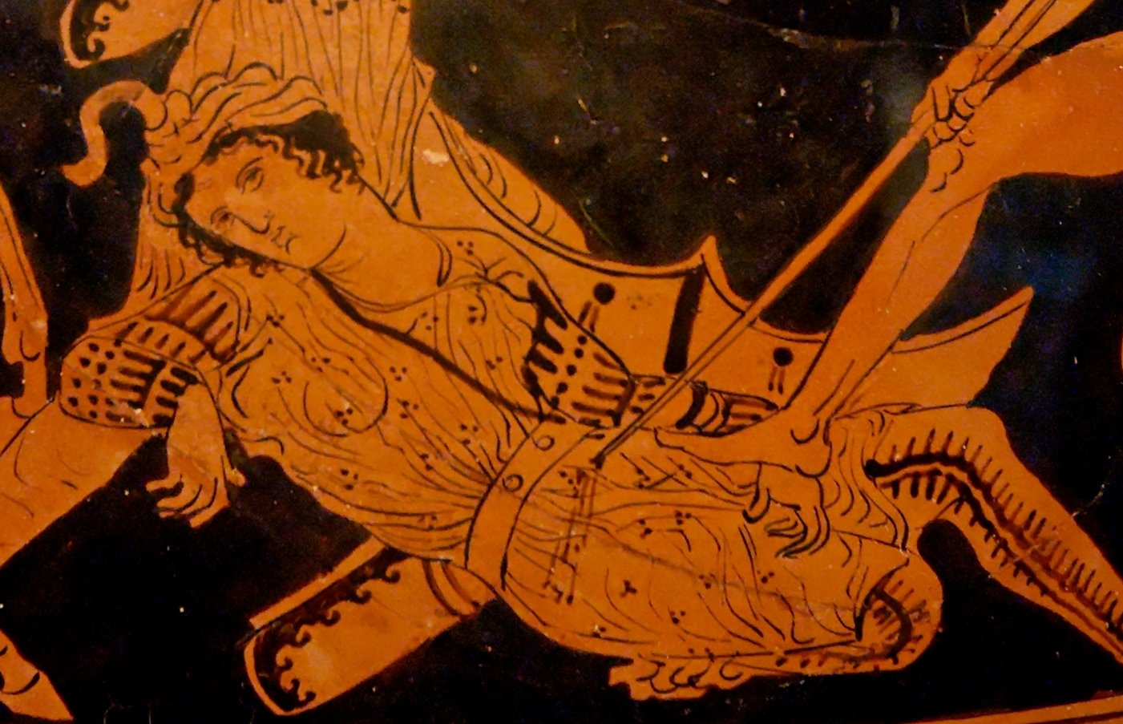
Sarpedon
“What is the point of being honored so
With precedence at table, choice of meat,
And brimming cups, at home in Lykia,
Like gods at ease in everyone’s regard?...
So that we two
At times like this in the Lykian front line
May face the blaze of battle and fight well,
That Lykian men-at-arms may say:
“They are no common men, our lords who rule
In Lykia. They eat fat lamb at feasts
And drink rare vintages, but the main thing is
Their fighting power, when they lead in combat!
Ah, cousin, could we but survive this war
To live forever deathless, without age,
I would not ever go again to battle,
Nor would I send you there for honor’s sake!
But now a thousand shapes of death surround us,
And no man can escape them, or be safe.
Let us attack – whether to give some fellow
Glory, or to win it from him. (12. 348-369)

Slide 24
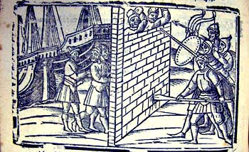
Hector Breaks Through
… and through the breach in glory Hektor leapt,
His visage dark as nightfall, though he shone
Terribly from the bronze that he was dressed in,
Carrying a brace of spears. No one could stop him,
None but the gods, as he leapt through the gate,
His eyes burning. Then he wheeled and called
The mass of Trojans to come charging on
Across the wall. And they obeyed him, some
By swarming over, others pouring through
The very gateway. And the Danaans broke
For their long ships in an uproar always rising.
(12. 516-526)

Slide 25
Quiz Question
5. What does Patroclus do in book 12?
Kill himself
Kill Hector
Enter the Greek camp
Sail home

